Slide 1
Chapter 5: Ethernet
Introduction to Networks
Notes:
Cisco Networking Academy program
Introduction to Networks
Chapter 5: Ethernet

Slide 2
Chapter 6 : Objectives
In this chapter, you will learn to:
Describe the operation of the Ethernet sublayers.
Identify the major fields of the Ethernet frame.
Describe the purpose and characteristics of the Ethernet MAC address.
Describe the purpose of ARP.
Explain how ARP requests impact network and host performance.
Explain basic switching concepts.
Compare fixed configuration and modular switches.
Configure a Layer 3 switch.

Slide 3
Ethernet Introduction
This chapter examines the characteristics and operation of Ethernet as it has evolved from a shared media, contention-based data communications technology to today's high bandwidth, full-duplex technology.

Slide 4
Chapter 5
5.0 Introduction
5.1 Ethernet Protocol
5.2 Address Resolution Protocol
5.3 LAN Switches
5.4 Summary
Notes:
Chapter 7 Sections

Slide 5
5.1 Ethernet Protocol

Slide 6
Ethernet Operation LLC and MAC Sublayers
Ethernet –
Most widely used LAN technology
Operates in the data link layer and the physical layer
Family of networking technologies that are defined in the IEEE 802.2 and 802.3 standards
Supports data bandwidths of 10, 100, 1000, 10,000, 40,000, and 100,000 Mbps (100 Gbps)
Ethernet standards –
Define Layer 2 protocols and Layer 1 technologies
Two separate sub layers of the data link layer to operate - Logical link control (LLC) and the MAC sublayers
Notes:
Section 5.1.1.1

Slide 7
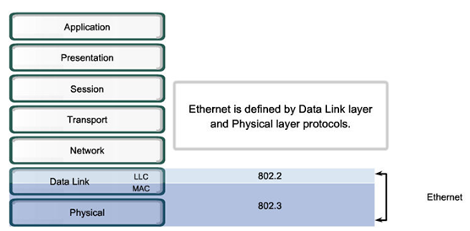
Ethernet Operation LLC and MAC Sublayers
Notes:
Section 5.1.1.1

Slide 8
Ethernet Operation LLC and MAC Sublayers
LLC
Handles communication between upper and lower layers
Takes the network protocol data and adds control information to help deliver the packet to the destination
MAC
Constitutes the lower sublayer of the data link layer
Implemented by hardware, typically in the computer NIC
Two primary responsibilities:
Data encapsulation
Media access control
Notes:
Section 5.1.1.1

Slide 9
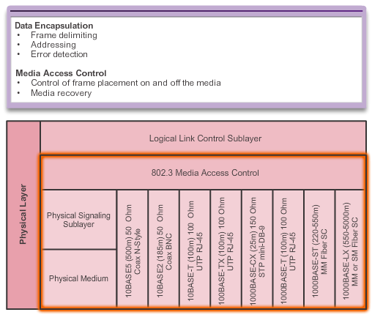
Ethernet Operation MAC Sublayer
Notes:
Section 5.1.1.2

Slide 10
Ethernet Operation MAC Sublayer
Data encapsulation
Frame assembly before transmission and frame disassembly upon reception of a frame
MAC layer adds a header and trailer to the network layer PDU
Provides three primary functions:
Frame delimiting – identifies a group of bits that make up a frame, synchronization between the transmitting and receiving nodes
Addressing – each Ethernet header added in the frame contains the physical address (MAC address) that enables a frame to be delivered to a destination node
Error detection - each Ethernet frame contains a trailer with a cyclic redundancy check (CRC) of the frame contents
Notes:
Section 5.1.1.2

Slide 11
Ethernet Operation MAC Sublayer
Media Access Control
Responsible for the placement of frames on the media and the removal of frames from the media
Communicates directly with the physical layer
If multiple devices on a single medium attempt to forward data simultaneously, the data will collide resulting in corrupted, unusable data
Ethernet provides a method for controlling how the nodes share access through the use a Carrier Sense Multiple Access (CSMA) technology
Notes:
Section 5.1.1.2

Slide 12
Ethernet Operation Media Access Control
Carrier Sense Multiple Access (CSMA) process
Used to first detect if the media is carrying a signal
If no carrier signal is detected, the device transmits its data
If two devices transmit at the same time - data collision
Notes:
Section 5.1.1.3

Slide 13
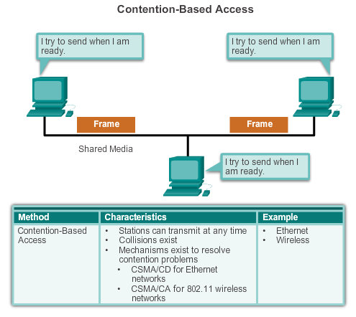
Ethernet Operation Media Access Control
Notes:
Section 5.1.1.3

Slide 14
Ethernet Operation Media Access Control
The two commonly used methods are:
CSMA/Collision Detection
The device monitors the media for the presence of a data signal
If a data signal is absent, indicating that the media is free, the device transmits the data
If signals are then detected that show another device was transmitting at the same time, all devices stop sending and try again later
While Ethernet networks are designed with CSMA/CD technology, with today’s intermediate devices, collisions do not occur and the processes utilized by CSMA/CD are really unnecessary
Wireless connections in a LAN environment still have to take collisions into account
Notes:
Section 5.1.1.3

Slide 15
Ethernet Operation Media Access Control
The two commonly used methods are:
CSMA/Collision Avoidance (CSMA/CA) media access method
Device examines the media for the presence of data signal - if the media is free, the device sends a notification across the media of its intent to use it
The device then sends the data.
Used by 802.11 wireless networking technologies
Notes:
Section 5.1.1.3

Slide 16
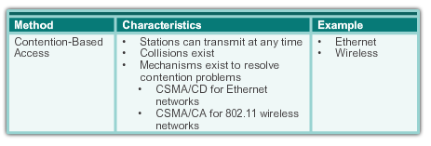
Ethernet Operation Media Access Control
Notes:
Section 5.1.1.3

Slide 17
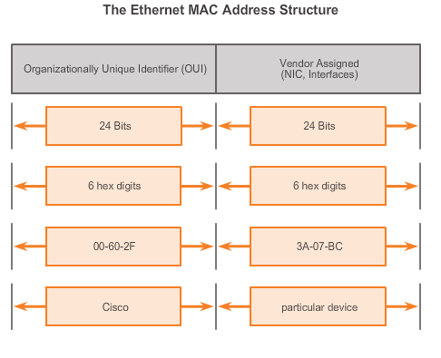
Ethernet Operation MAC Address: Ethernet Identity
Layer 2 Ethernet MAC address is a 48-bit binary value expressed as 12 hexadecimal digits
IEEE requires a vendor to follow two simple rules:
Must use that vendor's assigned OUI as the first 3 bytes
All MAC addresses with the same OUI must be assigned a unique value in the last 3 bytes
Notes:
Section 5.1.1.4

Slide 18
Ethernet Operation Frame Processing
MAC addresses assigned to workstations, servers, printers, switches, and routers
Example MACs: 00-05-9A-3C-78-00, 00:05:9A:3C:78:00, or 0005.9A3C.7800.
Forwarded message to an Ethernet network, attaches header information to the packet, contains the source and destination MAC address
Each NIC views information to see if the destination MAC address in the frame matches the device’s physical MAC address stored in RAM
No match, the device discards the frame
Matches the destination MAC of the frame, the NIC passes the frame up the OSI layers, where the decapsulation process takes place
Notes:
Section 5.1.1.5

Slide 19
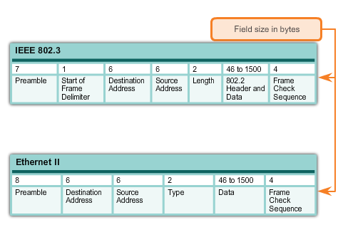
Ethernet Frame Attributes Ethernet Encapsulation
Early versions of Ethernet were relatively slow at 10 Mbps
Now operate at 10 Gigabits per second and faster
Ethernet frame structure adds headers and trailers around the Layer 3 PDU to encapsulate the message being sent
Ethernet II is the Ethernet frame format used in TCP/IP networks.
Notes:
Section 5.1.2.1

Slide 20
Ethernet Frame Attributes Ethernet Frame Size
Ethernet II and IEEE 802.3 standards define the minimum frame size as 64 bytes and the maximum as 1518 bytes
Less than 64 bytes in length is considered a "collision fragment" or "runt frame”
If size of a transmitted frame is less than the minimum or greater than the maximum, the receiving device drops the frame
At the physical layer, different versions of Ethernet vary in their method for detecting and placing data on the media
Notes:
Section 5.1.2.2

Slide 21
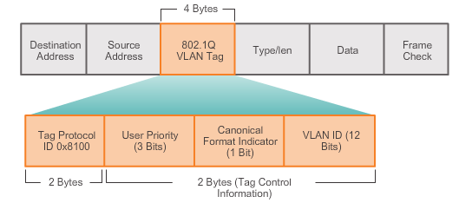
Ethernet Frame Attributes Ethernet Frame Size
The figure displays the fields contained in the 802.1Q VLAN tag
Notes:
Section 5.1.2.2

Slide 22
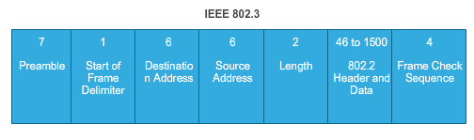
Ethernet Frame Attributes Introduction to the Ethernet Frame
Preamble and Start Frame Delimiter Fields
Used for synchronization between the sending and receiving devices
Length/Type Field
Defines the exact length of the frame's data field/ describes which protocol is implemented
Data and Pad Fields
Contain the encapsulated data from a higher layer, an IPv4 packet
Notes:
Section 5.1.2.3

Slide 23
Ethernet Frame Attributes Introduction to the Ethernet Frame
Frame Check Sequence Field
Used to detect errors in a frame with cyclic redundancy check (4 bytes), if calculations match at source and receiver, no error occurred.
Notes:
Section 5.1.2.3

Slide 24
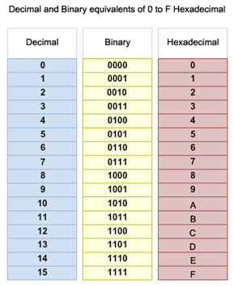
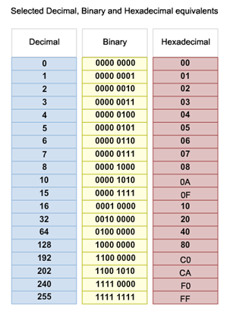
Ethernet MAC MAC Addresses and Hexadecimal
Notes:
Section 5.1.3.1

Slide 25
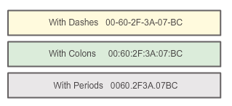
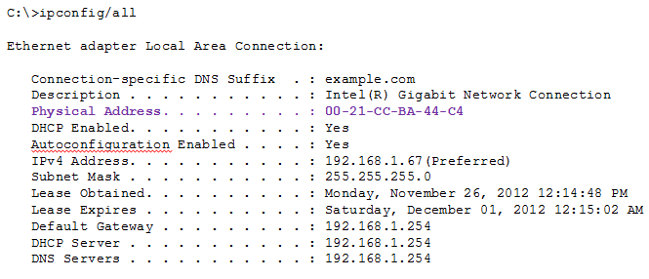
Ethernet MAC MAC Address Representations
Notes:
Section 5.1.3.2

Slide 26
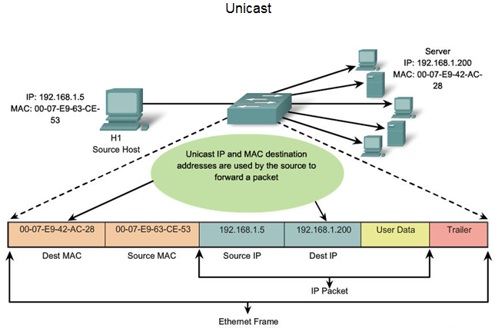
Ethernet MAC Unicast MAC Address
Notes:
Section 5.1.3.3

Slide 27
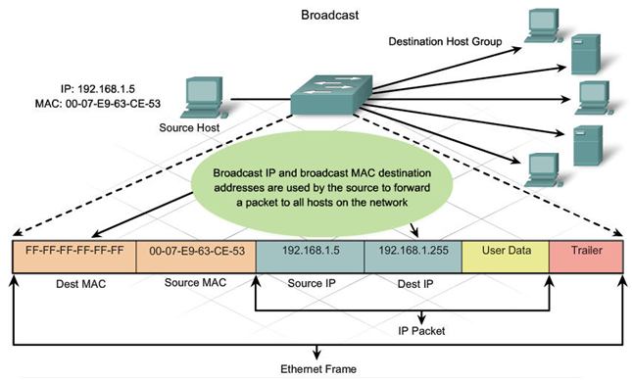
Ethernet MAC Broadcast MAC Address
Notes:
Section 5.1.3.4

Slide 28
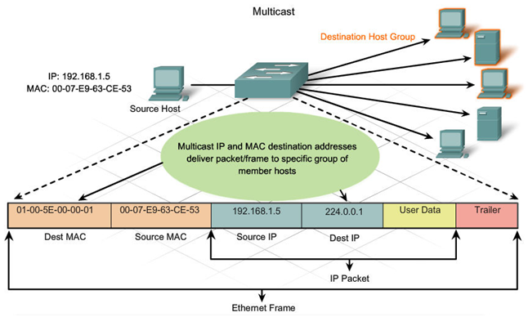
Ethernet MAC Multicast MAC Address
Multicast MAC address is a special value that begins with 01-00-5E in hexadecimal
Range of IPV4 multicast addresses is 224.0.0.0 to 239.255.255.255
Notes:
Section 5.1.3.5

Slide 29
MAC and IP MAC and IP
MAC address
This address does not change
Similar to the name of a person
Known as physical address because physically assigned to the host NIC
IP address
Similar to the address of a person
Based on where the host is actually located
Known as a logical address because assigned logically
Assigned to each host by a network administrator
Both the physical MAC and logical IP addresses are required for a computer to communicate just like both the name and address of a person are required to send a letter
Notes:
Section 5.1.4.1

Slide 30
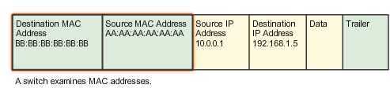
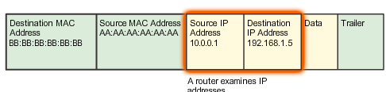
Ethernet MAC End-to-End Connectivity, MAC, and IP
Notes:
Section 5.1.4.2

Slide 31
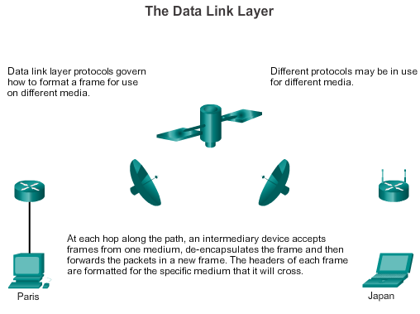
Ethernet MAC End-to-End Connectivity, MAC, and IP
Notes:
Section 5.1.4.2

Slide 32
5.2 Address Resolution Protocol

Slide 33
ARP Introduction to ARP
ARP Purpose
Sending node needs a way to find the MAC address of the destination for a given Ethernet link
The ARP protocol provides two basic functions:
Resolving IPv4 addresses to MAC addresses
Maintaining a table of mappings
Notes:
Section 5.2.1.1

Slide 34
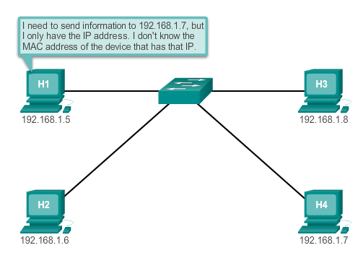
ARP Introduction to ARP
Notes:
Section 5.2.1.1

Slide 35
ARP ARP Functions/Operation
ARP Table –
Used to find the data link layer address that is mapped to the destination IPv4 address
As a node receives frames from the media, it records the source IP and MAC address as a mapping in the ARP table
ARP request –
Layer 2 broadcast to all devices on the Ethernet LAN
The node that matches the IP address in the broadcast will reply
If no device responds to the ARP request, the packet is dropped because a frame cannot be created
Static map entries can be entered in an ARP table, but this is rarely done
Notes:
Section 5.2.1.2/5.2.1.3

Slide 36
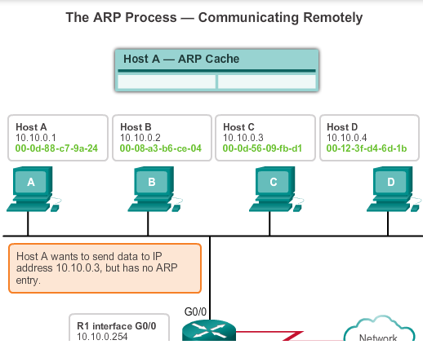
ARP ARP Functions/Operation
Notes:
Section 5.2.1.3

Slide 37
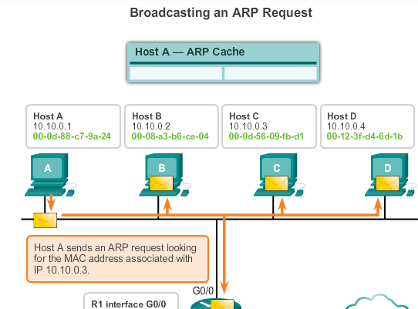
ARP ARP Functions/Operation
Notes:
Section 5.2.1.3

Slide 38
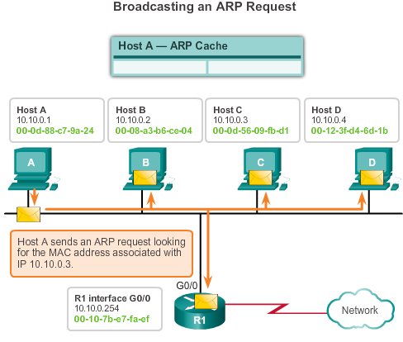
ARP ARP Functions/Operation
Notes:
Section 5.2.1.2/5.2.1.3

Slide 39
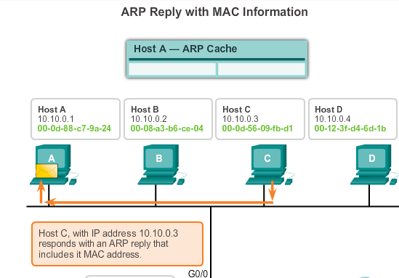
ARP ARP Functions/Operation
Notes:
Section 5.2.1.3

Slide 40
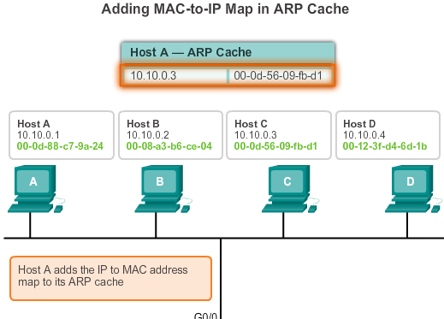
ARP ARP Functions/Operation
Notes:
Section 5.2.1.3

Slide 41
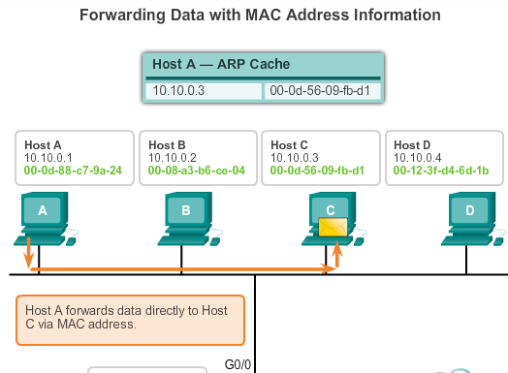
ARP ARP Functions/Operation
Notes:
Section 5.2.1.3

Slide 42
ARP ARP Role in Remote Communication
If the destination IPv4 host is on the local network, the frame will use the MAC address of this device as the destination MAC address
If the destination IPv4 host is not on the local network, the source uses the ARP process to determine a MAC address for the router interface serving as the gateway
In the event that the gateway entry is not in the table, an ARP request is used to retrieve the MAC address associated with the IP address of the router interface
Notes:
Section 5.2.1.4

Slide 43
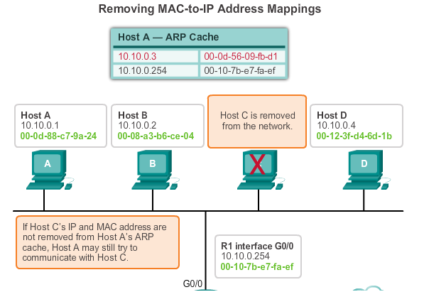
ARP Removing Entries from an ARP Table
ARP cache timer removes ARP entries that have not been used for a specified period of time
Commands may also be used to manually remove all or some of the entries in the ARP table
Notes:
Section 5.2.1.5

Slide 44
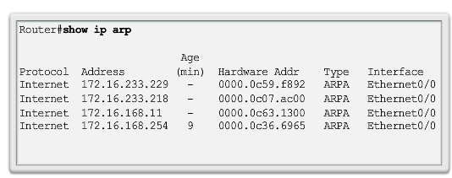
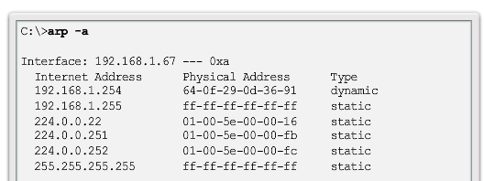
ARP ARP Tables on Networking Devices
Notes:
Section 5.2.1.6

Slide 45
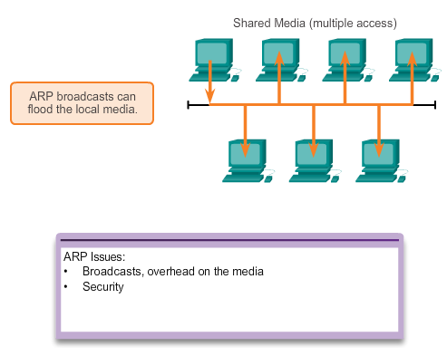
ARP Issues How ARP Can Create Problems
Notes:
Section 5.2.2.1

Slide 46
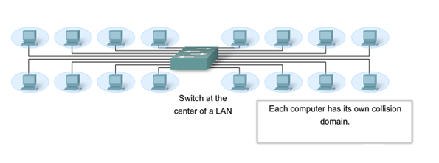
ARP Issues Mitigating ARP Problems
Notes:
Section 5.2.2.2

Slide 47
5.3 LAN Switches

Slide 48
Switching Switch Port Fundamentals
Layer 2 LAN switch
Connects end devices to a central intermediate device on most Ethernet networks
Performs switching and filtering based only on the MAC address
Builds a MAC address table that it uses to make forwarding decisions
Depends on routers to pass data between IP subnetworks
Notes:
Section 5.3.1.1

Slide 49
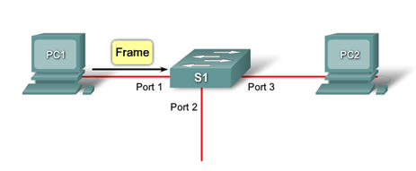
Switching Switch MAC Address Table
1. The switch receives a broadcast frame from PC 1 on Port 1.
2. The switch enters the source MAC address and the switch port that received the frame into the address table.
3. Because the destination address is a broadcast, the switch floods the frame to all ports, except the port on which it received the frame.
4. The destination device replies to the broadcast with a unicast frame addressed to PC 1.
Continued…
Notes:
Section 5.3.1.2

Slide 50
Switching Switch MAC Address Table
5. The switch enters the source MAC address of PC 2 and the port number of the switch port that received the frame into the address table. The destination address of the frame and its associated port is found in the MAC address table.
6. The switch can now forward frames between source and destination devices without flooding, because it has entries in the address table that identify the associated ports.
Notes:
Section 5.3.1.2

Slide 51
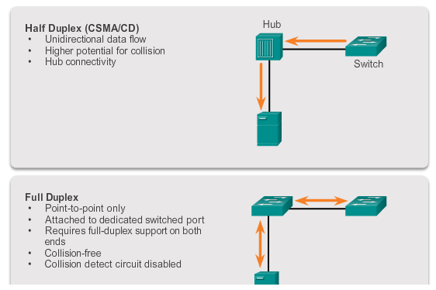
Switching Duplex Settings
Notes:
Section 5.3.1.3

Slide 52
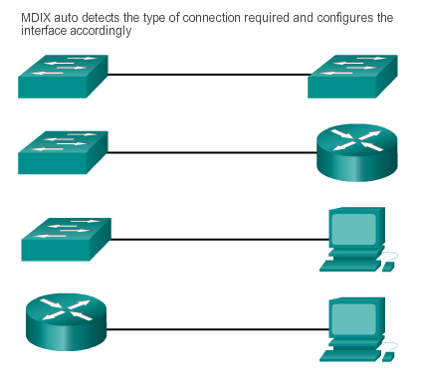
Switching Auto-MDIX
Notes:
Section 5.3.1.4

Slide 53
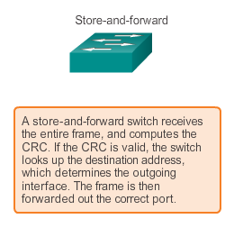
Switching Frame Forwarding Methods on Cisco Switches
Notes:
Section 5.3.1.5

Slide 54
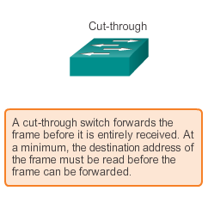
Switching Cut-through Switching
Two variants:
Fast-forward switching:
Lowest level of latency immediately forwards a packet after reading the destination address, typical cut-through method of switching
Fragment-free switching:
Switch stores the first 64 bytes of the frame before forwarding, most network errors and collisions occur during the first 64 bytes
Notes:
Section 5.3.1.6

Slide 55
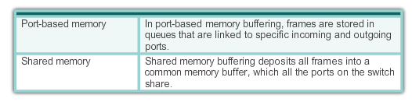
Switching Memory Buffering on Switches
Notes:
Section 5.3.1.8

Slide 56
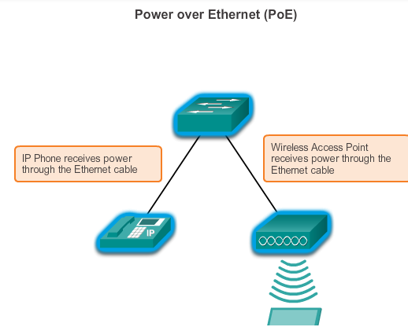
Fixed or Modular Fixed verses Modular Configuration
Notes:
Section 5.3.2.1

Slide 57
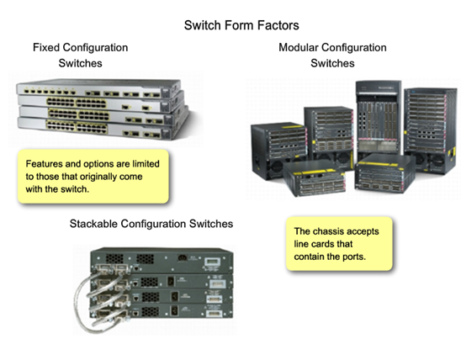
Fixed or Modular Fixed verses Modular Configuration
Notes:
Section 5.3.2.1

Slide 58
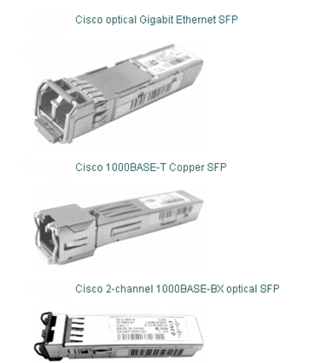
Fixed or Modular Module Options for Cisco Switch Slots
Notes:
Section 5.3.2.2

Slide 59
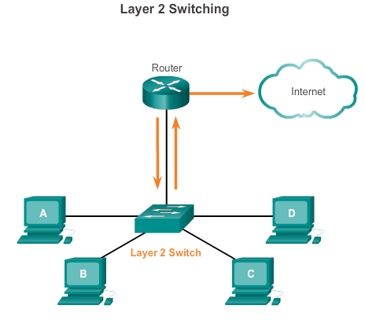
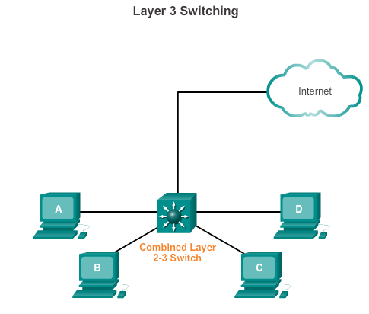
Layer 3 Switching Layer 2 verses Layer 3 Switching
Notes:
Section 5.3.3.1

Slide 60
Layer 3 Switching Cisco Express Forwarding
Two main components:
Forwarding information base (FIB)
Conceptually similar to a routing table
A networking device uses this lookup table to make destination-based switching decisions during Cisco Express Forwarding operation
Updated when changes occur in the network and contains all routes known at the time
Adjacency tables
Maintain layer 2 next-hop addresses for all FIB entries
Notes:
Section 5.3.3.2

Slide 61
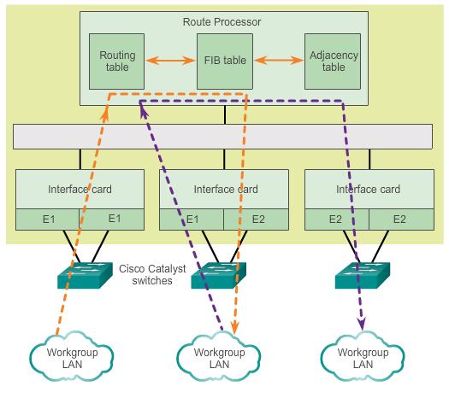
Layer 3 Switching Cisco Express Forwarding
Notes:
Section 5.3.3.2

Slide 62
Layer 3 Switching Types of Layer 3 Interfaces
The major types of Layer 3 interfaces are:
Switch Virtual Interface (SVI) – Logical interface on a switch associated with a virtual local area network (VLAN).
Routed Port – Physical port on a Layer 3 switch configured to act as a router port. Configure routed ports by putting the interface into Layer 3 mode with the no switchport interface configuration command.
Layer 3 EtherChannel – Logical interface on a Cisco device associated with a bundle of routed ports.
Notes:
Section 5.3.3.3

Slide 63
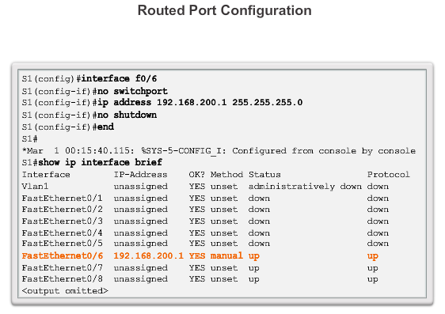
Layer 3 Switching Configuring a Routed Port on a Layer 3 Switch
Notes:
Section 5.3.3.4

Slide 64
Chapter 5 Summary
Ethernet is the most widely used LAN technology used today.
Ethernet standards define both the Layer 2 protocols and the Layer 1 technologies.
The Ethernet frame structure adds headers and trailers around the Layer 3 PDU to encapsulate the message being sent.
As an implementation of the IEEE 802.2/3 standards, the Ethernet frame provides MAC addressing and error checking.
Replacing hubs with switches in the local network has reduced the probability of frame collisions in half-duplex links.
Notes:
Section 5.4

Slide 65
Chapter 5 Summary
The Layer 2 addressing provided by Ethernet supports unicast, multicast, and broadcast communications.
Ethernet uses the Address Resolution Protocol to determine the MAC addresses of destinations and map them against known Network layer addresses.
Each node on an IP network has both a MAC address and an IP address.
The ARP protocol resolves IPv4 addresses to MAC addresses and maintains a table of mappings.
A Layer 2 switch builds a MAC address table that it uses to make forwarding decisions.
Notes:
Section 5.4

Slide 66
Chapter 5 Summary
Layer 3 switches are also capable of performing Layer 3 routing functions, reducing the need for dedicated routers on a LAN.
Layer 3 switches have specialized switching hardware so they can typically route data as quickly as they can switch.
Notes:
Section 5.4

Slide 67


